Slide 1


VL2: A Scalable and Flexible Data Center Network
Presented By:
Mahek Desai
Apoorva Rumale
Department Of Computer Science
California State University, Northridge

Slide 2
VL2: A Scalable and Flexible Data Center Network
Authors:
Albert Greenberg, James R. Hamilton,
Navendu Jain, Srikanth Kandula,
Changhoon Kim, Parantap Lahiri,
David A. Maltz, Parveen Patel
and Sudipta Sengupta
Presented At:
Special Interest Group on Data Communication, 2009

Slide 3
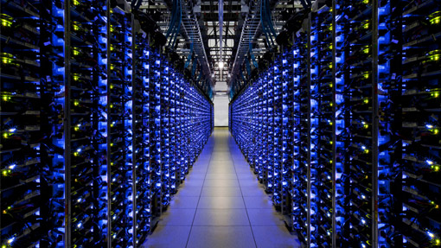
TABLE OF CONTENT
INTRODUCTION
DATA CENTER ENVIRONMENT
LIMITATIONS OF CURRENT DATA CENTER NETWORK TOPOLOGY
SOLUTION
EVALUATION
STRENGTHS
WEAKNESSES
OUR IDEAS TO ENHANCE CURRENT METHOD
SUMMARY

Slide 4

INTRODUCTION
The primary focus for a cloud service data center is:
Agility Priority.
Reduced Network Oversubscription.
Isolation for Service Stability.
Decreased Routing Complexity.
In essence, a shift towards an agile, non-oversubscribed, and more robust network design is crucial for modern cloud service data centers to optimize their performance and reliability.

Slide 5

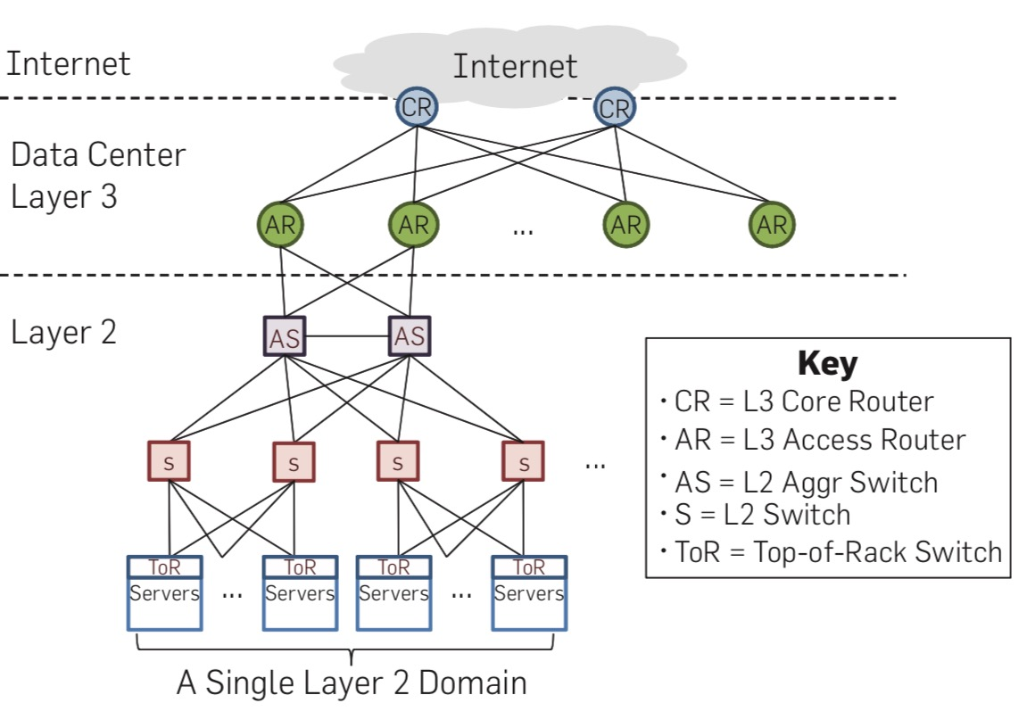
DATA CENTER ENVIRONMENT

Slide 6
DATA CENTER ENVIRONMENT (Cont.)
The paper studies traffic patterns and network churn in production data center of a cloud service provider and presents the following key findings:
Most traffic is internal to the data center.
The network bottlenecks computation.
Volatile traffic patterns.
Frequent failures.
Structured flow sizes.

Slide 7
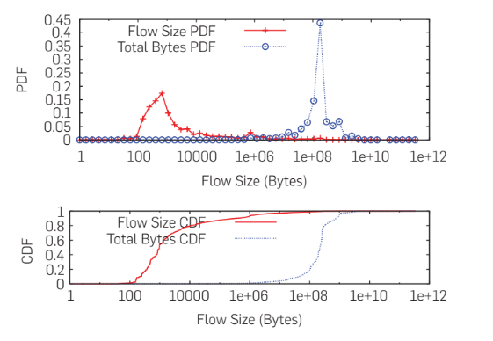
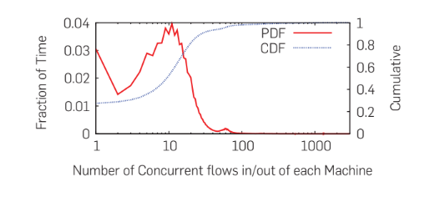
DATA CENTER ENVIRONMENT (Cont.)

Slide 8

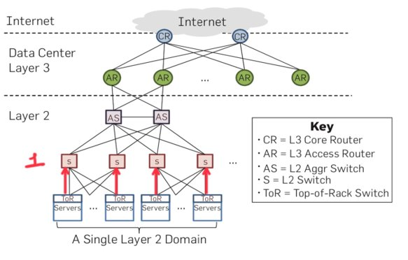
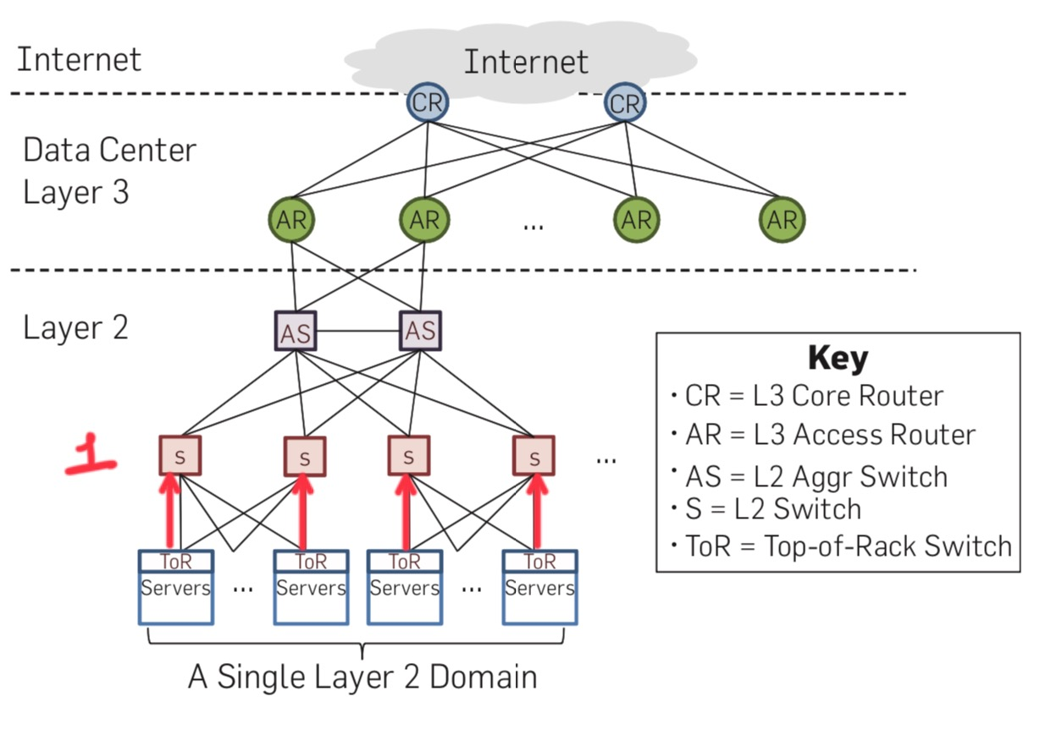
LIMITATIONS OF CURRENT DATA CENTER NETWORK TOPOLOGY

Slide 9
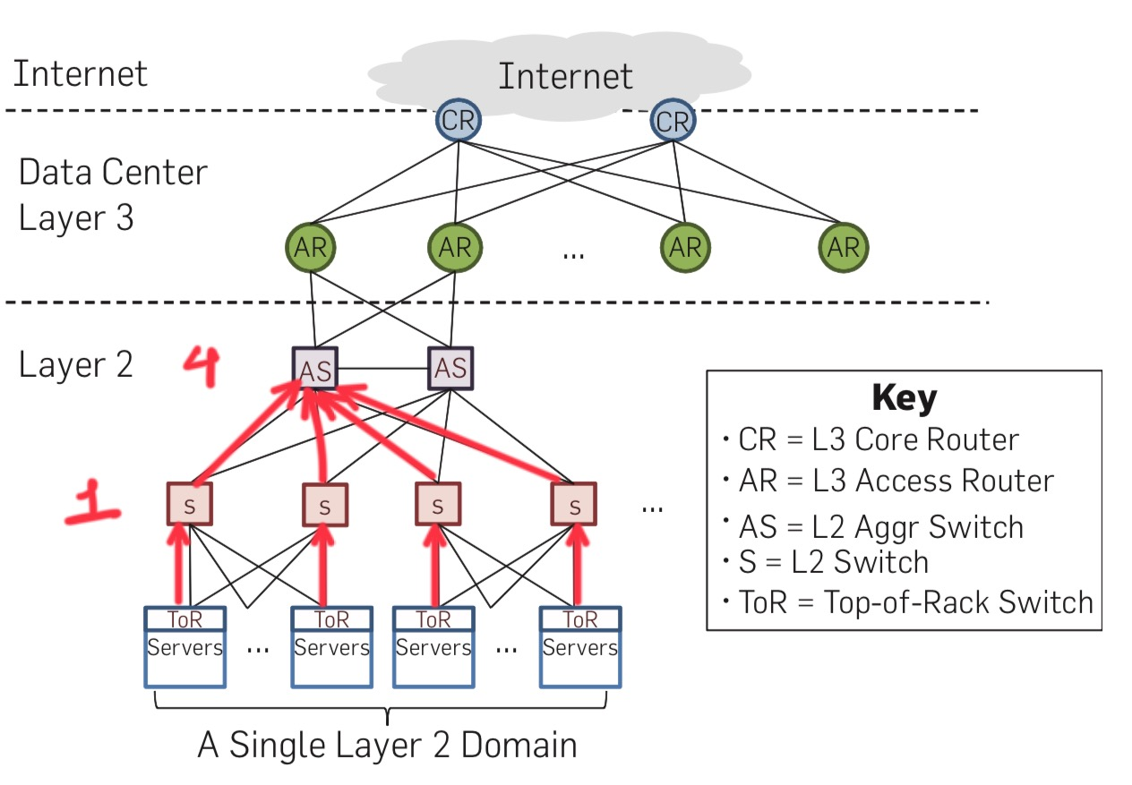
LIMITATIONS OF CURRENT DATA CENTER NETWORK TOPOLOGY (Cont.)

Slide 10
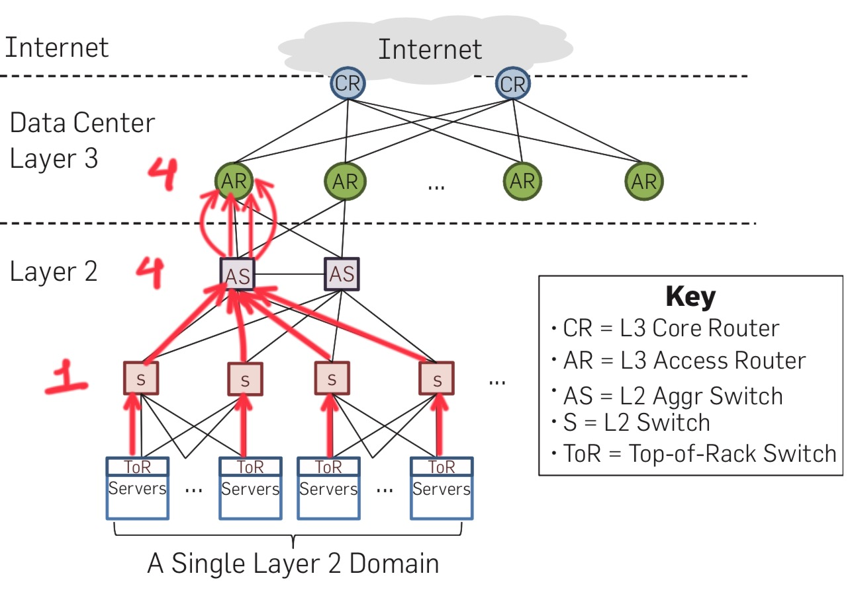
LIMITATIONS OF CURRENT DATA CENTER NETWORK TOPOLOGY (Cont.)

Slide 11
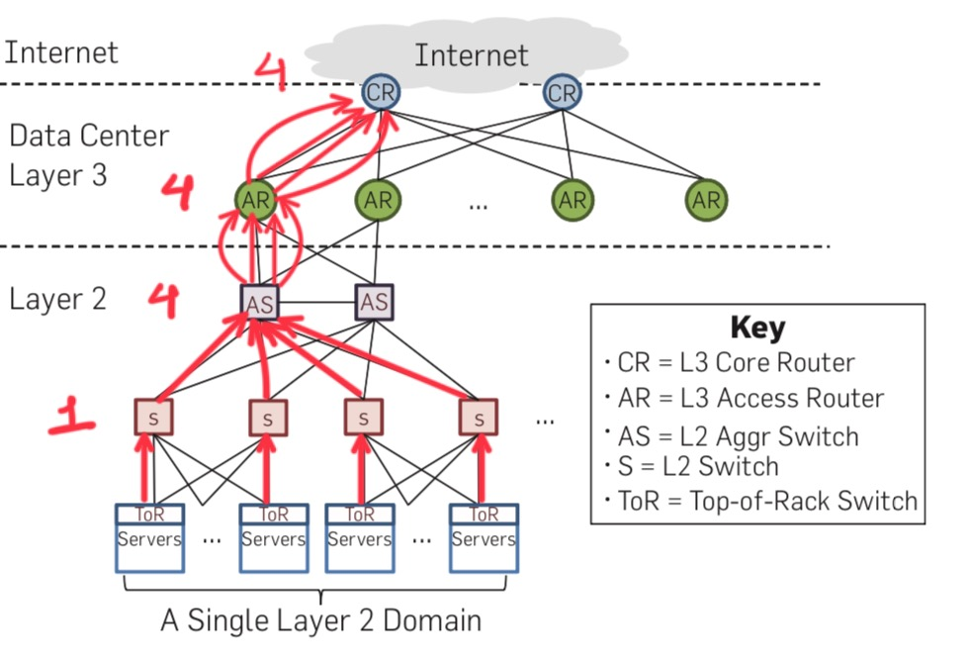
LIMITATIONS OF CURRENT DATA CENTER NETWORK TOPOLOGY (Cont.)

Slide 12
LIMITATIONS OF CURRENT DATA CENTER NETWORK TOPOLOGY (Cont.)
Lack of enough capacity:
Conventional tree-like network configuration have Hotspots and congestion due to oversubscription 80 to 240x.
Lack of isolation:
If a part of sub-tree is highly loaded, the performance of other parts of the network is also affected.
Routing:
Network is partitioned due to the usage of location specific addressing. Thus reassigning servers are complicated (Not Agile).

Slide 13

SOLUTION
To achieve performance isolation, agility and to reduce oversubscription: Scale-out Topology and Valiant Load Balancing (VLB).
To improve routing: Equal Cost Multi-Path Routing (ECMP) along with anycast addresses.
To attain agility and maximize capacity: Directory System (DS).

Slide 14

SCALE-OUT TOPOLOGY

Slide 15
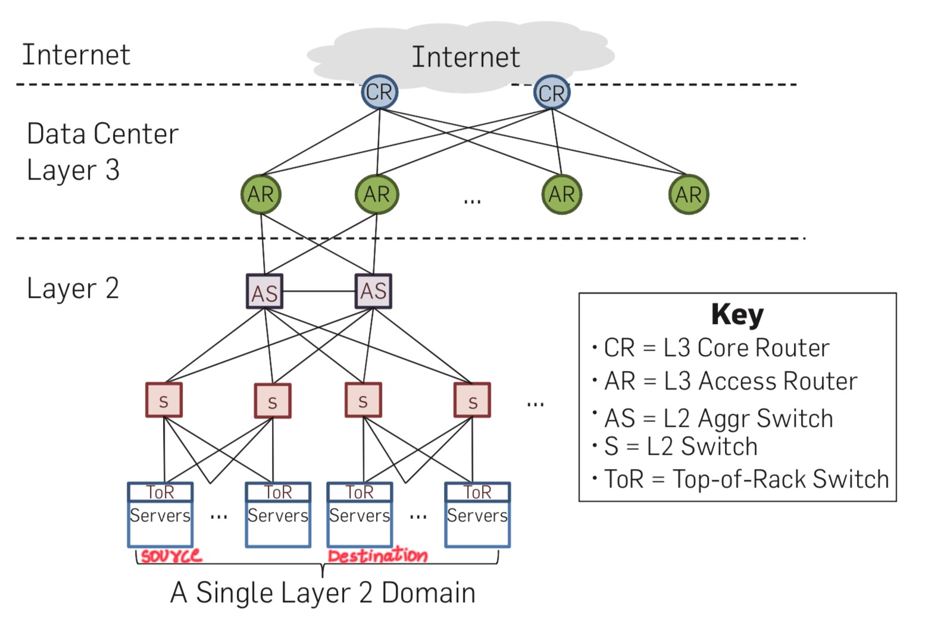
VALIANT LOAD BALANCING (VLB)

Slide 16
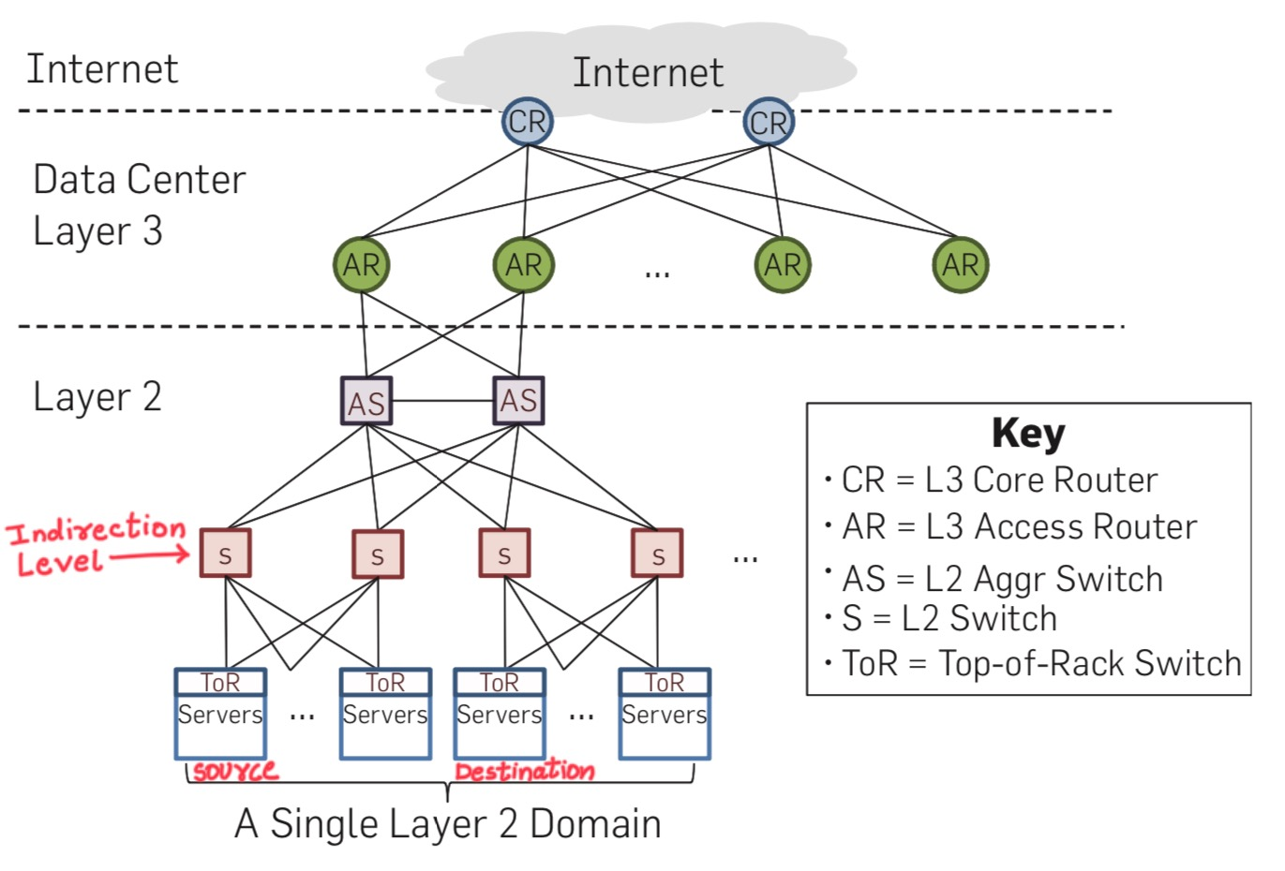
VALIANT LOAD BALANCING (VLB) (Cont.)

Slide 17
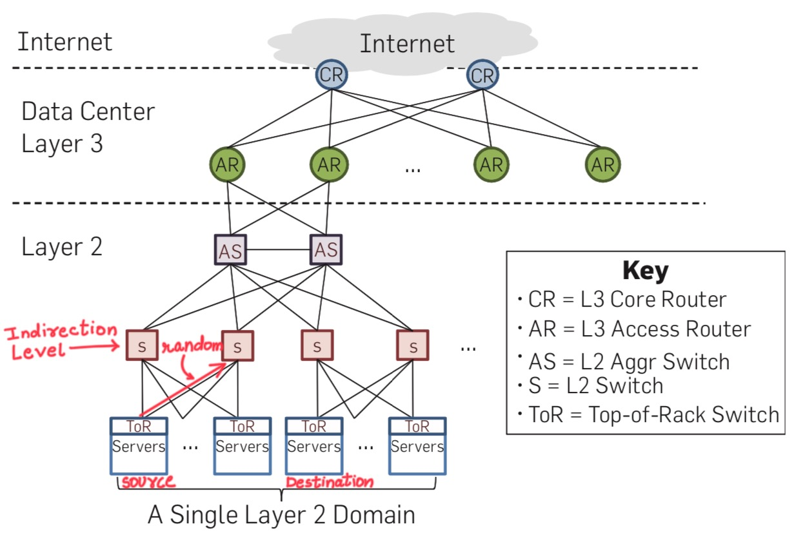
VALIANT LOAD BALANCING (VLB) (Cont.)

Slide 18
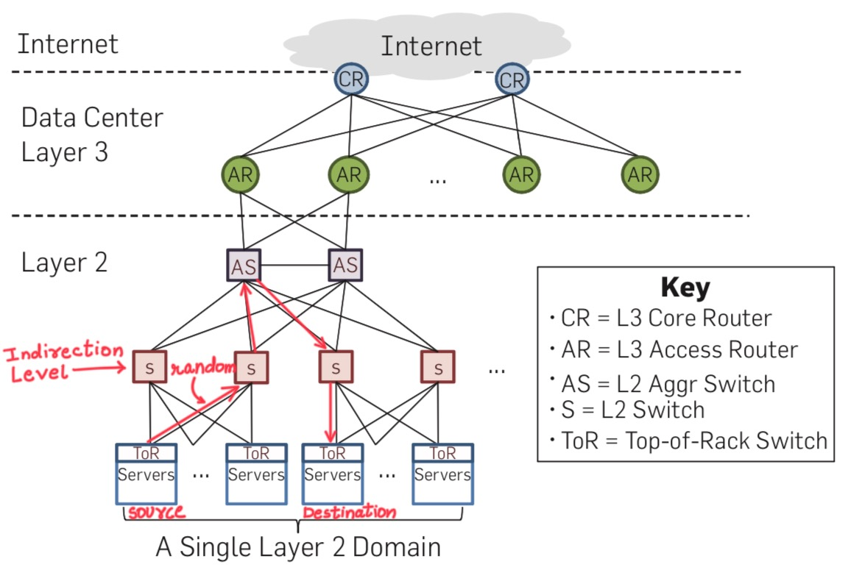
VALIANT LOAD BALANCING (VLB) (Cont.)

Slide 19
EQUAL COST MULTI-PATH ROUTING(ECMP) ALONG WITH ANYCAST ADDRESSES
In the context of anycast addresses, ECMP is employed to distribute traffic among multiple routers or devices that host the same anycast address.
When a packet is sent to the anycast address, the ECMP algorithm selects the best router based on routing metrics, like path cost or hop count.

Slide 20
DIRECTORY SYSTEM (DS)
Key terms:
Application-specific Addresses (AA).
Location-specific Addresses (LA).
Replicated State Machine (RSM).
Lookup.
Update.

Slide 21
LOCATION-SPECIFIC ADDRESS (LA)
Assigned based on the physical location of network resources or servers in the data center.
Each server or network device is given a unique LA.
Efficient routing and load balancing.
Helping resources communicate effectively within the data center.

Slide 22
APPLICATION-SPECIFIC ADDRESS (AA)
Assigned to help controlling and securing inter-data center communication.
Each application or service is assigned a unique AA.
Used for network isolation and security.
Enable different applications or services to communicate securely across multiple data center locations.

Slide 23
REPLICATED STATE MACHINE (RSM)
It is a component or function that is responsible for managing and coordinating the replication of data across multiple servers or nodes.
RSM helps maintain data consistency across these replicas
RSM ensures that requests from clients are directed to the appropriate replica for the service they need.
RSM ensure that they are available and reliable even in the event of server or node failures.

Slide 24
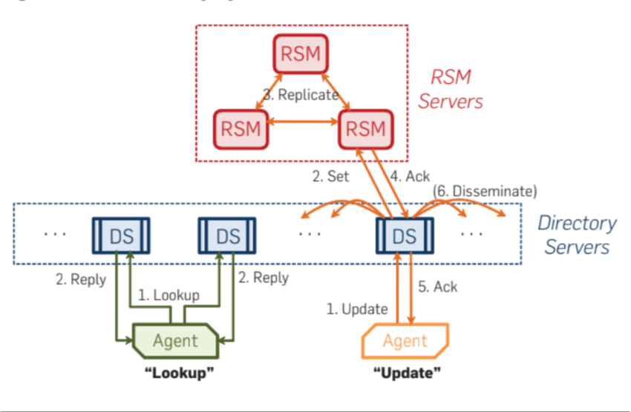
LOOKUP AND UPDATE PROCEDURE

Slide 25

EVALUATION
Test Setup:
80 server testbed and 10 commodity switches.
Clos network topology consisting of 3 intermediate switches (3 ports of 24 Gbps each), 3 aggregation switches (6 ports of 24 Gbps each) and 4 ToRs (2 ports of 10Gbps and 24 ports of 1 Gbps).

Slide 26
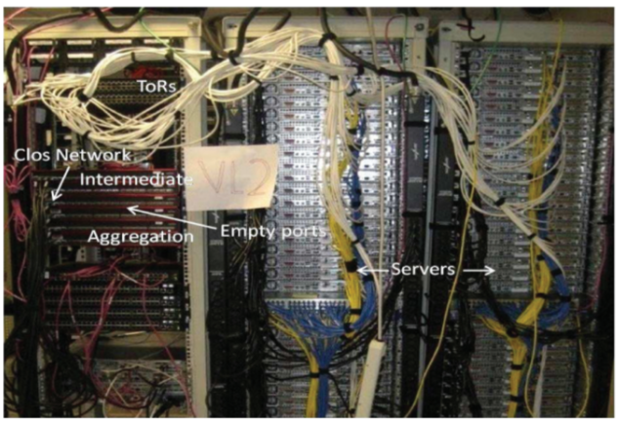
EVALUATION (Cont.)

Slide 27
EVALUATION (Cont.)
Evaluated Entities:
Uniform High Capacity.
Performance Isolation.
Directory System Performance.

Slide 28
UNIFORM HIGH CAPACITY
An all-to-all data shuffle traffic matrix involving 75 servers. Each of 75 servers must deliver 500MB of data to each of the 74 other servers—a shuffle of 2.7TB from memory to memory.
VL2 achieves:
Efficiency -> 94%.
Aggregate Throughput -> 58.8 Gbps.
A fairness index -> 0.995 (mean goodput per flow 11.4Mbps, standard deviation 0.75Mbps).

Slide 29
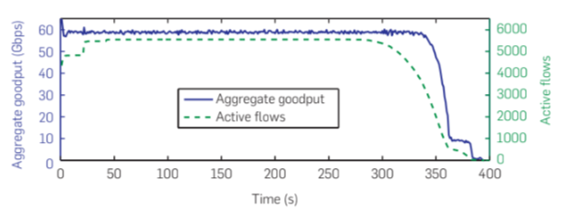
UNIFORM HIGH CAPACITY (Cont.)

Slide 30
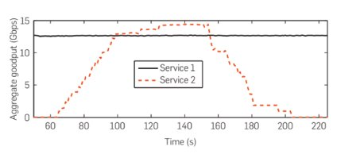
PERFORMANCE ISOLATION
Two services were initiated. Service 1 runs continuously, while service 2 involves intermittent 8GB transfers.
Despite the presence of service 2 and its data transfers, it is observed that the aggregate throughput of service 1 remained unchanged, indicating minimal impact.

Slide 31
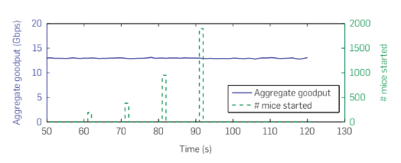
PERFORMANCE ISOLATION (Cont.)
Additionally, the introduction of a large number of short TCP connections (referred to as "mice") did not adversely affect the throughput of service 1.
These results demonstrate that the system effectively ensures performance isolation, even in the presence of varying network conditions and loads.

Slide 32
DIRECTORY SYSTEM PERFORMANCE
Setup:
50 machines with 3-5 RSM nodes and 3-7 directory servers.
Lookup/Update:
Agents generate bursts of lookup and update requests to directory servers.
The first response is accepted.
Resilience:
Vary the number of directory servers while keeping the workload constant at a rate of 32K lookups/sec and 4K updates/sec.

Slide 33
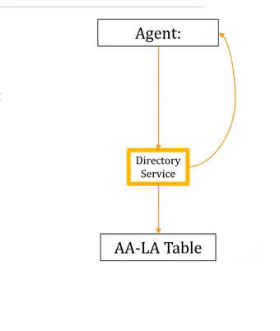
DIRECTORY SYSTEM PERFORMANCE (Cont.)
Result:
Lookup rate: 17K lookups/sec (with less than 10ms latency per server).
Update rate: 4K updates/sec (with less than 600ms latency per server).
Incrementally Scalable: 17K lookups and 4K updates with each additional server.
Individual DS failure does not compromise the system.

Slide 34

STRENGTHS
Scalability.
Flexibility.
Efficient traffic engineering.
Fault tolerance.
Reduced operational complexity.

Slide 35
WEAKNESSES
Implementation complexity.
Hardware and software requirements.
Limited real-world validation.
Network management overhead.
Compatibility with existing applications.

Slide 36
OUR IDEAS TO ENHANCE CURRENT METHOD
To Reduce Wiring Complexity:
Leverage capabilities of optics and wireless.
To Reduce Overhead during High Loads:
Hybrid Switch Router Topology when the traffic is predictable.
This might make the system more complex but we need to examine if the reduction of overhead outweighs the complexity added to the system in order to implement it.

Slide 37
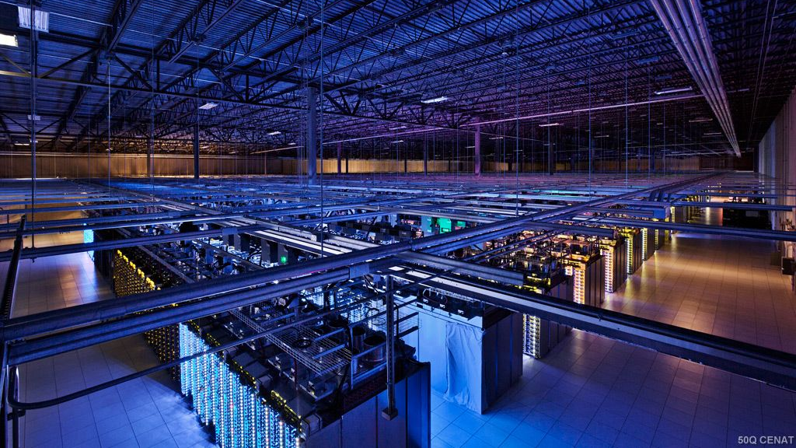
SUMMARY
VL2 is an efficient agile network architecture which avoids oversubscription.
It is a simple design which can be realized with existing networking technologies.
It employs Scale-Out Topology and ECMP along with Anycast Addresses to improve routing.
It incorporates a directory system for efficient management of virtual networks within the data center.
It uses Valiant Load Balancing (VLB) to split flow evenly achieving high efficiency (94%) and high fairness (0.995).

Slide 38
THANK YOU

Slide 39
ANY QUESTIONS?

